Slide 1

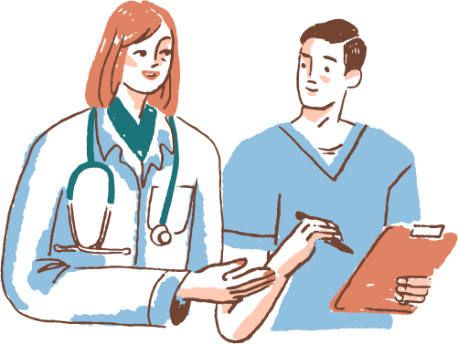

ENHANCING HEALTHCARE ACCESS: INNOVATIONS IN
AI-driven Medical Information Services
Created by: Pranay Singhvi
Tathagat Sengupta
Adwait Purao

Slide 2

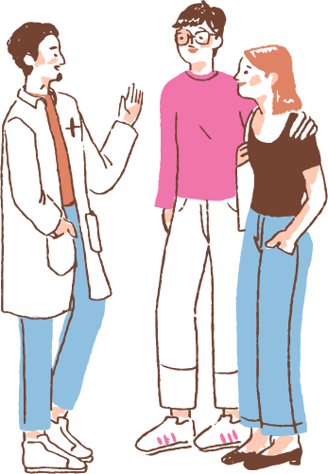

CONTENTS
Doctor’s Point of View
Case Study
Problem Statement
Scope of the Project
Objectives of the Project
Literature Survey
Flowchart of Application
System Design
Implementation

Slide 3


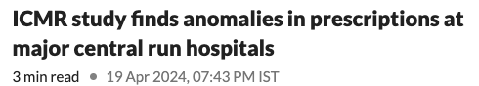
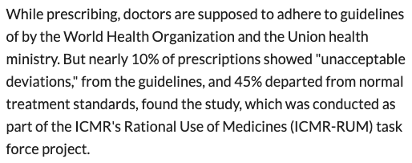
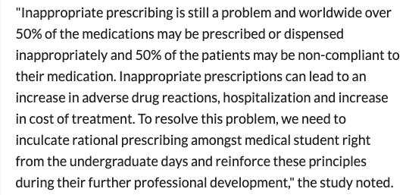
ARTICLES

Slide 4
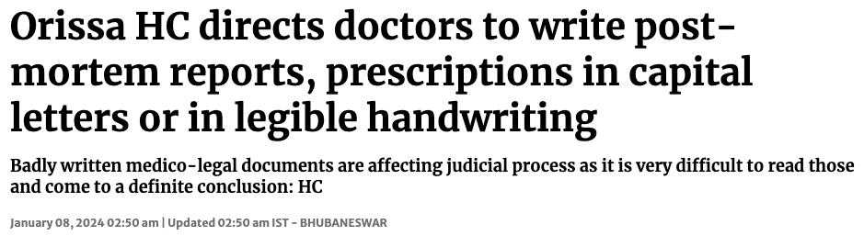
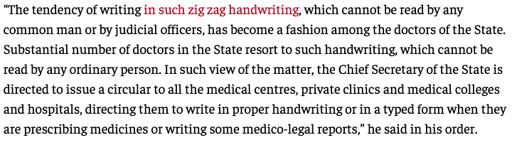
ARTICLES

Slide 5
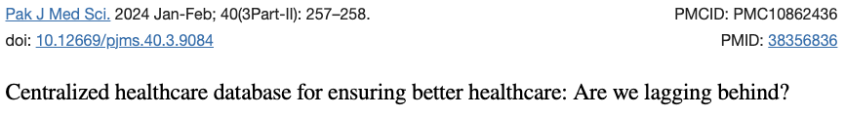
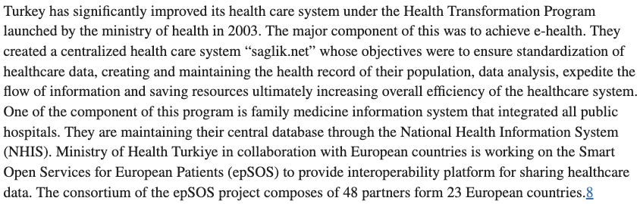
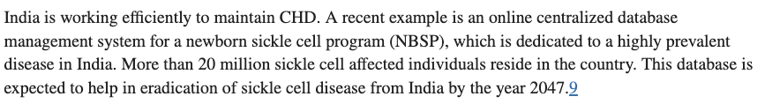
ARTICLES

Slide 6
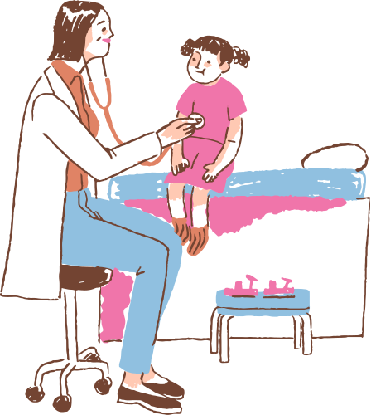

DOCTOR’S POINT OF VIEW
In today's rapidly evolving healthcare landscape, it's imperative to leverage cutting-edge technology to enhance patient care. From the perspective of a doctor, the following services are essential for an efficient and patient-centric chatbot platform:
1.Prescription Recommendation: Provide accurate medication suggestions based on patient symptoms and medical history.
2.Latest Medicine News: Keep patients informed about the newest advancements and treatments in the medical field.
3.Image Recognition: Analyze medical images for diagnosis and treatment planning.
4. QR Prescription: Simplify prescription retrieval for patients through QR code technology.
5. Text Generation for Health Query: Generate informative responses to patient health queries in real-time.
6. OCR Handwriting Recognition: Convert handwritten prescriptions or notes into digital text for easy access and understanding.
7. Digital Prescription: Issue prescriptions digitally for convenient access and storage.
8. Online Appointment Reservation: Allow patients to schedule appointments seamlessly through the chatbot platform.
9. Online Report Management: Enable patients to securely store and manage their medical reports online.
By integrating these services into a chatbot platform, doctors can streamline patient interactions, improve accessibility to healthcare services, and ultimately enhance patient outcomes.

Slide 7
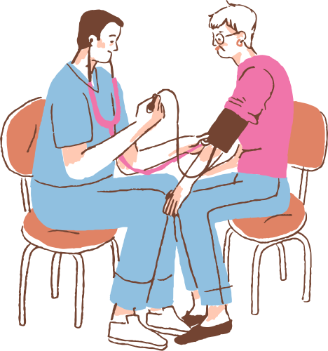
CASE STUDY
Prescription Recommendation & Digital Prescription: Imagine a scenario where a patient, John, visits his doctor for a consultation. Using the MedTech app, the doctor seamlessly generates a digital prescription tailored to John's needs, considering his medical history and current condition.
Latest Medicine News & Text Generation for Health Query: John, curious about his prescribed medication, accesses the app to stay updated with the latest medicine news. He also inputs his queries regarding potential side effects, and the app generates detailed, easy-to-understand responses, empowering him with knowledge.
Image Recognition & OCR Handwriting Recognition: For patients with complex prescriptions or handwritten notes, the app employs image recognition and OCR handwriting recognition technologies. John simply uploads an image of his prescription, and the app accurately transcribes it into digital text for easy access and understanding.
QR Prescription & Online Appointment Reservation: Utilizing QR code technology, John conveniently retrieves his prescription details from the app whenever needed. Additionally, he schedules his follow-up appointments seamlessly through the app's online reservation system, eliminating the hassle of long waiting times.
Examination Seriousness: In critical situations, the app identifies the seriousness of examinations based on medical data, prioritizing urgent cases and facilitating prompt medical attention.

Slide 8
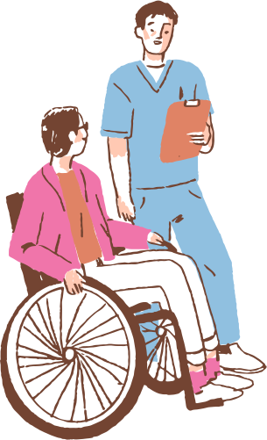

PROBLEM STATEMENT
1. Predicting Patient Condition Severity: Develop a system to assess the seriousness of a patient's condition by asking targeted questions and using the responses to predict the severity level, aiding in prioritizing patient care effectively.
2. Disease Recognition from Images: Implement image recognition technology to identify diseases like Alzheimer's, lung cancer, and breast cancer from medical images, enabling early detection and intervention.
3. Text Generation for Health Queries: Create a text generation model capable of addressing common health queries from users, providing accurate and timely responses.
4. Handwriting Recognition for Prescriptions: Implement handwriting recognition to decipher prescriptions accurately, aiding patients in identifying prescribed medications.
5. Digitizing Prescriptions with QR Codes: Transform paper prescriptions into digital format using QR codes to reduce errors and enable easy access for pharmacists, enhancing prescription management and patient safety.
6. Centralized Database for Patient Records: Establish a centralized database containing comprehensive patient history, reports, and prescriptions to support healthcare professionals in understanding patient issues and making informed decisions efficiently.

Slide 9

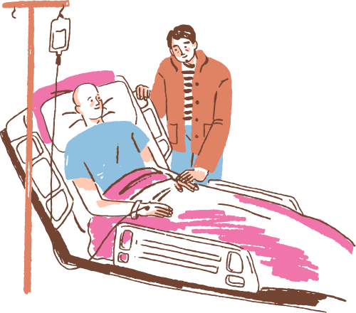
SCOPE OF THE PROJECT
Develop algorithms to predict the severity of patient conditions based on specific questions, aiding in efficient examination prioritization and treatment planning.
Implement a real-time medical news feed to keep users and hospital management updated with relevant healthcare information for informed decision-making.
Utilize advanced image recognition to identify diseases like Alzheimer's, lung cancer, breast cancer, and more from medical images, enabling early diagnosis and treatment.
Deploy a text generation model to address common health queries, providing accurate and contextual responses to users.
Analyze blood report documents using AI techniques to extract meaningful insights for healthcare professionals, aiding in diagnosis and treatment decisions.
Implement handwriting recognition technology to simplify medication identification from prescriptions, enhancing patient safety and convenience.
Digitize entire prescriptions to reduce paper usage and minimize prescription errors, integrating QR code technology for secure prescription access and medication dispensing.
Develop a centralized database to store and manage patient history, reports, and prescriptions, providing healthcare providers with a comprehensive understanding of patient issues for data-driven decision-making.

Slide 10





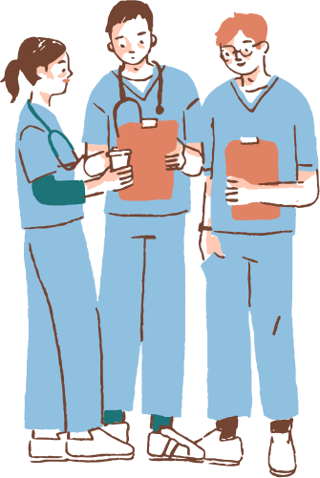

Optimize Prescription Management:
Implement handwriting recognition to facilitate easy identification of prescribed medications for patients and digitize entire prescriptions to reduce paper use, enhance accuracy, and mitigate malpractices.
Improve Information Accessibility:
Enable Seamless Data Analysis:
Develop a comprehensive system that provides hospital staff and patients with the latest medical news, disease recognition capabilities through image inputs, and automated text generation for addressing common health queries.
Leverage AI for analyzing blood report documents, summarizing findings, and storing data centrally in a secure database for comprehensive patient history access and informed decision-making by healthcare professionals.
Objective
Enhance Patient Care Delivery:
Enhance Communication:
Utilize predictive modeling and AI-driven assessments to accurately gauge the seriousness of patient conditions, enabling timely and prioritized examination and treatment.
Integrate automatic speech recognition and speech-to-speech translation features to improve communication between hospital staff and patients, ensuring accessibility and understanding across diverse language barriers.

Slide 11


SERVICES PROVIDED BY OUR CHATBOT
Prescription recommendation
Risk Prediction
Latest medicine news
Image recognition
QR prescription
Text generation for health query
OCR handwriting recognition
Digital prescription
Online appointment reservation
Online report management
Centralised Medical Record

Slide 12
LITERATURE SURVEY
Title | Year | Author | Inference | Gaps
Gemini: A Family of Highly Capable Multimodal Models | 2023 | Gemini Team, Google | Multimodal Supremacy Potential for Transformation The Power of Scale | Dataset Details Beyond Human Benchmarks Computational Cost
The survey: Text generation models in deep learning | 2020 | Touseef Iqbal , Shaima Qureshi | Deep Learning Excellence Evolution in NLP Advancements in Deep Generative Modeling The Journey of Text Generation Models Exploring DL Approaches | Lack of theoretical foundation Interpretability Data and resource requirements Overreliance on training data

Slide 13
LITERATURE SURVEY
Title | Year | Author | Inference | Gaps
A Hybrid Approach Handwritten Character Recognition for Mizo using Artificial Neural Network | 2018 | J. Hussain and Vanlalruata | Hybrid approach with neural networks. Hybrid segmentation merges blobs. Hybrid feature extraction improves accuracy. BPNN achieves 98% accuracy. | feature extraction algorithm Online, cursive recognition Text-to-speech
BmQGen: Biomedical Query Generator for Knowledge Discovery | 2015 | Feichen Shen, Hongfang Liu, Sunghwan Sohn, David W Larson, Yugyung Lee | Converts text to RDF/OWL. Clusters data based on semantics. Generates cross-domain queries. Case study on surgical reports. | Improve information extraction. Enhance annotation quality. Enhance performance, scalability. Test on other domains.

Slide 14
Title | Year | Author | Inference | Gaps
Detection of Alzheimer's Disease with Shape Analysis of MRI Images | 2018 | Hiroki Fuse, Kota Oishi, Norihide Maikusa, Tadanori Fukami | Brain shape for classification. P-type Fourier descriptor. Outperforms volume ratio. Shape may be more useful. | Analyze complex shapes. Longitudinal analysis needed. Interpret shape features. Larger dataset required
Chest X-Ray Analysis of Tuberculosis by Deep Learning with Segmentation and Augmentation | 2018 | Sergii Stirenko*, Yuriy Kochura, Oleg Alienin, Oleksandr Rokovyi, and Yuri Gordienko | CXR analysis with deep learning. Efficient lung segmentation. Lossless and lossy data augmentation. Improvement in CADx. | Small dataset limitations. Variability in image quality. Influence of external regions. Need for further validation.
Disease Risk Prediction by Using Convolutional Neural Network | 2018 | Sayali Ambekar,Rashmi Phalnikar | Data analysis in healthcare. Heart disease prediction. CNN-UDRP algorithm. | Missing data handling. Accuracy improvement needed. Literature review lacks depth.

Slide 15
Title | Year | Author | Inference | Gaps
Handwritten Optical Character Recognition (OCR): A Comprehensive Systematic Literature Review (SLR) | 2020 | JAMSHED MEMON , MAIRA SAMI , RIZWAN AHMED KHAN , AND MUEEN UDDIN | Deep learning (CNN) utilized in OCR. Script-specific techniques employed. Scarcity of datasets for non-mainstream languages. Need for commercialized, real-time OCR solutions. | Limited research on other languages need for more datasets potential accuracy improvement
Handwritten Text Recognition Using Deep Learning Techniques | 2020 | L.Navya, MD.Farhan Ali, K.Pavan Sai K.Shyam, Alabazar Ramesh | 1. HTR using deep learning gains attention. 2. OCR and HCR enable paperless environment. 3. Modules and components of HTR system. 4. Improving accuracy with deep learning and techniques like image enhancement. | Methodology description lacking. Limited discussion on system limitations. Insufficient results analysis and comparison. Lack of validation on real-world datasets.

Slide 16
Title | Year | Author | Inference | Gaps
Implementing Digital Signature for the Secure Electronic Prescription Using QR-Code Based on Android Smartphone | 2016 | Mohamad Ali Sadikin, Septia Ulfa Sunaringtyas | Digital signature implementation. Proposal of RSA algorithm. Aim for secure application. Testing methodologies employed. | Insufficient method details. Lack of discussion on challenges. Absence of empirical evidence. Ethical and legal concerns overlooked.
Learning models for writing better doctor prescriptions | 2019 | Tingting Xu, Ioannis Ch. Paschalidis | Data-driven optimization for Type 2 diabetes prescriptions. Potential to enhance prescription policies for other diseases. Combines regression and classification for policy optimization. Improves prescription efficacy through data-driven strategies. | Reliance on EHRs raises data privacy concerns. Limited regression model comparison for treatment prediction. Challenges with multinomial logistic regression for policy learning. Lack of analysis on risks of modifying prescription policies.

Slide 17
Title | Year | Author | Inference | Gaps
Semi-Supervised Natural Language Processing Approach for Fine-Grained Classification of Medical Reports | 2019 | Neil Deshmukh Moravian Academy Bethlehem | Semi-supervised NLP for fine-grained medical report classification. Uses unsupervised language model for document encodings. Trained on clinical reports, classifiers on labeled datasets. Achieves high AUCs (0.98, 0.95, 0.99) for occlusion, stroke, hemorrhage. | Lacks details on dataset limitations and biases. Fails to address ethical implications of patient data use. No comparison with existing methods or state-of-the-art. Does not address model interpretability for medical trust.
Handwritten Character Recognition in English: A Survey | 2015 | Monica Patel1, Shital P. Thakkar | Review of Handwritten Character Recognition (HCR) in English language. Discusses HCR system stages: pre-processing, segmentation, feature extraction, classification. Examines methods: holistic, segmentation-based, recognition-based segmentation with strengths/weaknesses. Emphasizes feature extraction, classification for accurate recognition in HCR. | No 100% accuracy achieved; indicates ongoing limitations/challenges. Limited to English language; excludes other language character recognition. Lack of dataset details affects result generalizability. Missing comparative analysis of classifiers, features; method limitations not discussed.

Slide 18
Title | Year | Author | Inference | Gaps
Quick Response Code: Medication Prescription | 2020 | Nurul Fatina Yusni, Noreha Che Sidik, Nur Farah Hanani Mohd Zaim Shamsul Jamel Elias, Siti Khairul Niza Sukri, Zanariah Idrus, | Introduces Medication Prescription QR Code for efficient medicine information retrieval. Implemented at Universiti Teknologi MARA, Kedah, Malaysia. Positive impact on users: efficient info access, reduced paper use. Users find MPQRC easy, time-saving, preferred over traditional methods. | Small sample size (30 respondents) limits representativeness. No comparison with other medication information access methods. Limited scope to one case study, lacks generalizability. Short-term maintenance; lacks long-term evaluation for sustainability.

Slide 19
LITERATURE OUTCOME
1. Handwritten Character Recognition (HCR) and Optical Character Recognition (OCR)
Hussain and Vanlalruata (2018) introduced a hybrid approach for handwritten character recognition in Mizo using artificial neural networks, highlighting the importance of combining methodologies for accurate HCR.
Memon et al. (2020) conducted a systematic literature review on handwritten OCR systems, emphasizing advancements in preprocessing, feature extraction, and classification techniques.
2. Disease Risk Prediction and Diagnosis
Ambekar and Phalnikar (2018) demonstrated the application of convolutional neural networks (CNNs) for predicting disease risks, showing the potential of deep learning in medical diagnostics.
Stirenko and Kochura (2018) applied deep learning with segmentation and augmentation techniques for tuberculosis diagnosis using chest X-rays, showcasing the effectiveness of automated image analysis in healthcare.
Fuse et al. (2018) explored MRI-based shape analysis for detecting Alzheimer's disease, demonstrating the integration of imaging and shape recognition for early diagnosis.
enabling efficient and error-free prescription management.
Sadikin and Sunaringtyas (2016) developed a secure electronic prescription system with digital signatures and QR codes, improving data security in healthcare transactions.

Slide 20
LITERATURE OUTCOME
3. Natural Language Processing in Healthcare
Deshmukh (2019) proposed a semi-supervised NLP approach for classifying medical reports, providing insights into fine-grained analysis and information retrieval in the healthcare domain.
Shen et al. (2015) presented a biomedical query generator (BmQGen), aiding knowledge discovery through precise query formulation in biomedical contexts.
4. Multimodal and Multilingual Models
The Gemini Team (2024) and Meta (2024) introduced advanced multimodal and multilingual models (e.g., Gemini and SeamlessM4T) that facilitate cross-lingual understanding and integration of text, image, and other modalities for diverse applications.
5. Document and Layout Analysis
Yiheng Xu et al. (2019) proposed LayoutLM, a pre-trained model for document image understanding that combines text and layout features, enhancing OCR and document analysis.
6. QR-Code Based Applications in Healthcare
Yusni et al. (2020) implemented a QR-code-based system for medication prescriptions, enabling efficient and error-free prescription management.
Sadikin and Sunaringtyas (2016) developed a secure electronic prescription system with digital signatures and QR codes, improving data security in healthcare transactions.

Slide 21
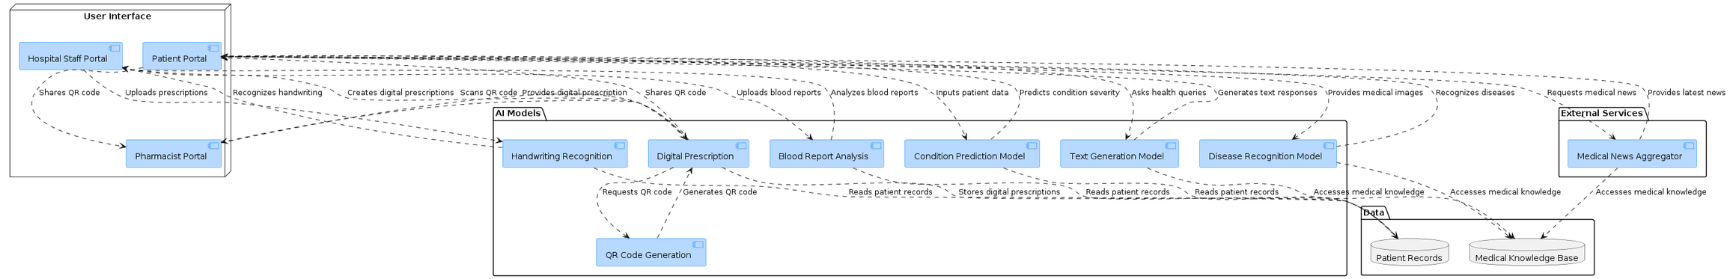
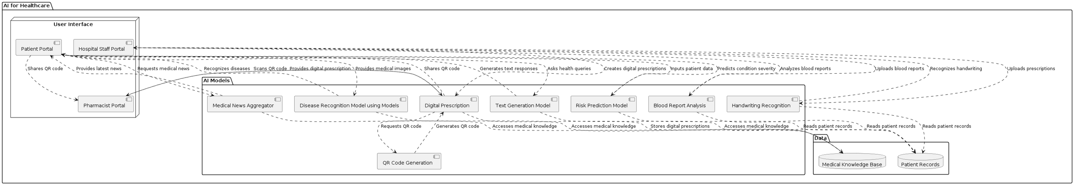
FLOWCHART
SYSTEM DESIGN

Slide 22
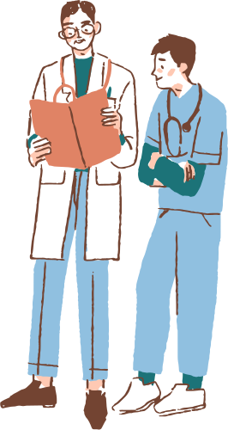
IMPLEMENTATION

Slide 23

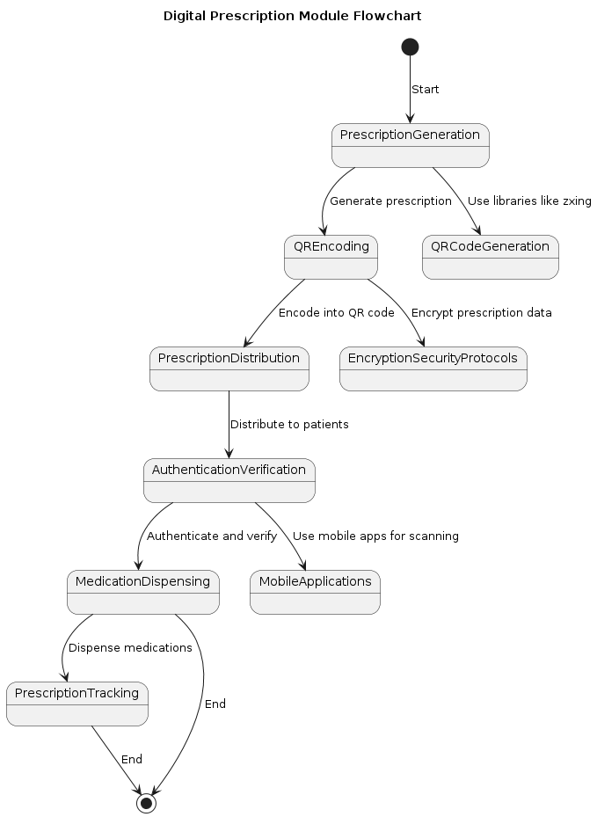
PRESCRIPTION RECOMMENDATION
FLOWCHART

Slide 24
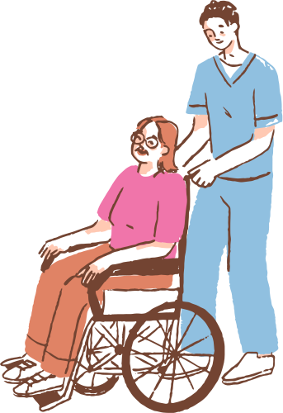
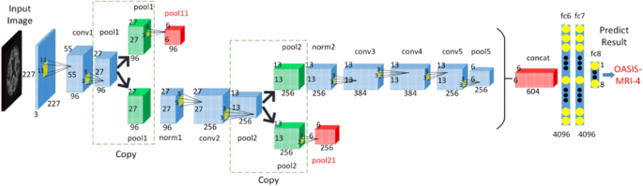
IMAGE RECOGNITION
FLOWCHART

Slide 25
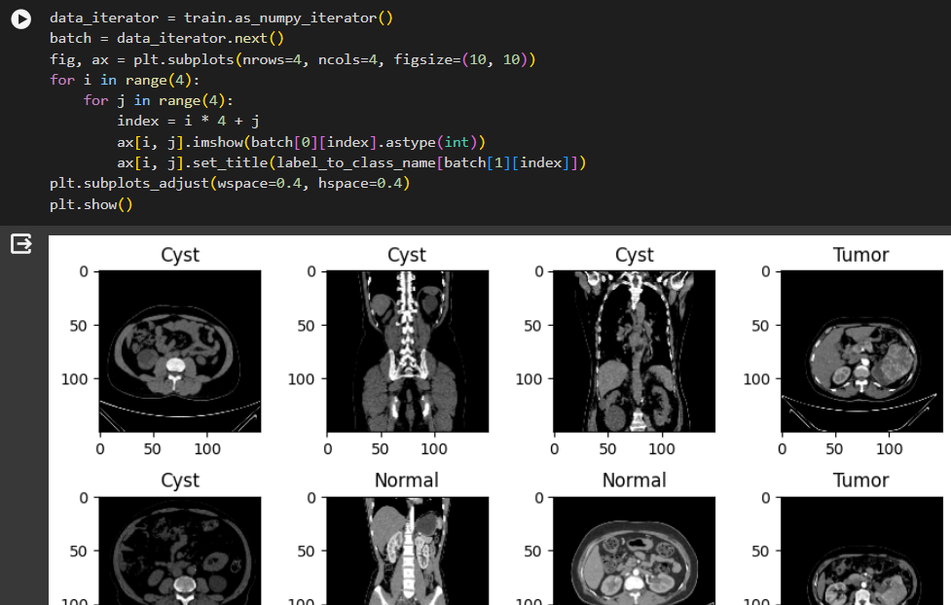
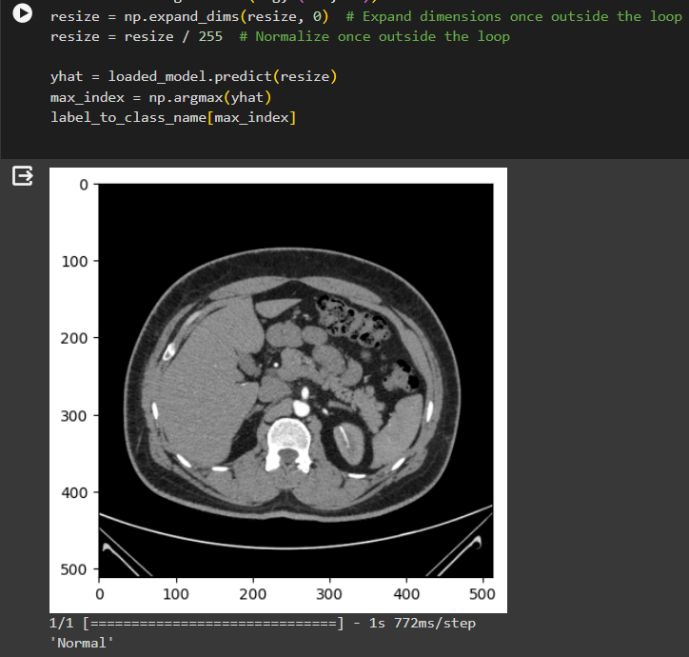
IMPLEMENTATION

Slide 26
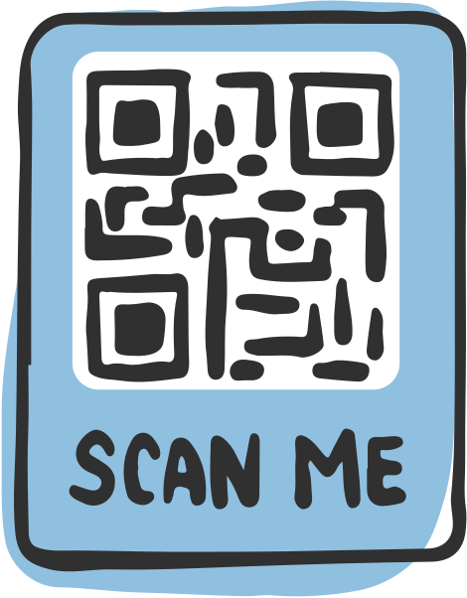
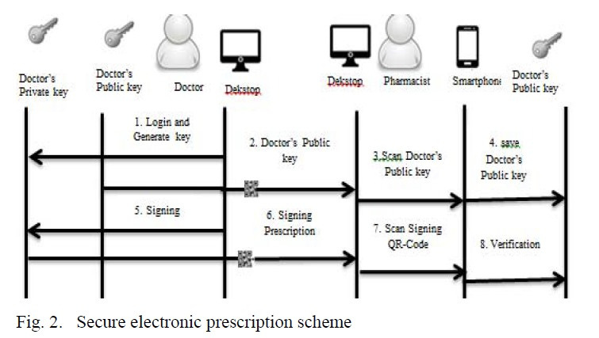
QR PRESCRIPTION
FLOWCHART

Slide 27

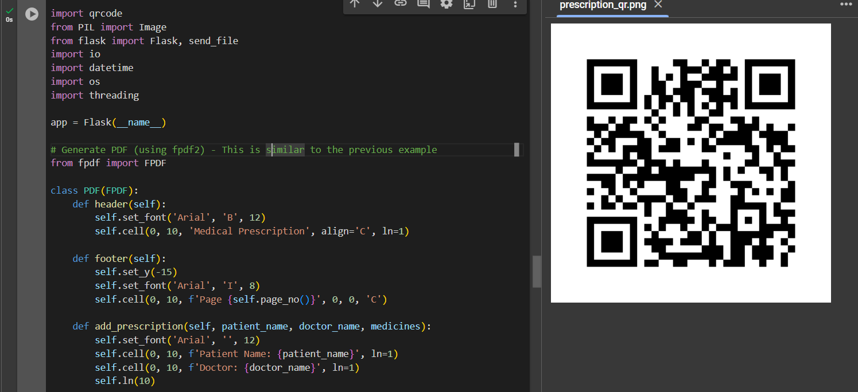
QR PRESCRIPTION

Slide 28
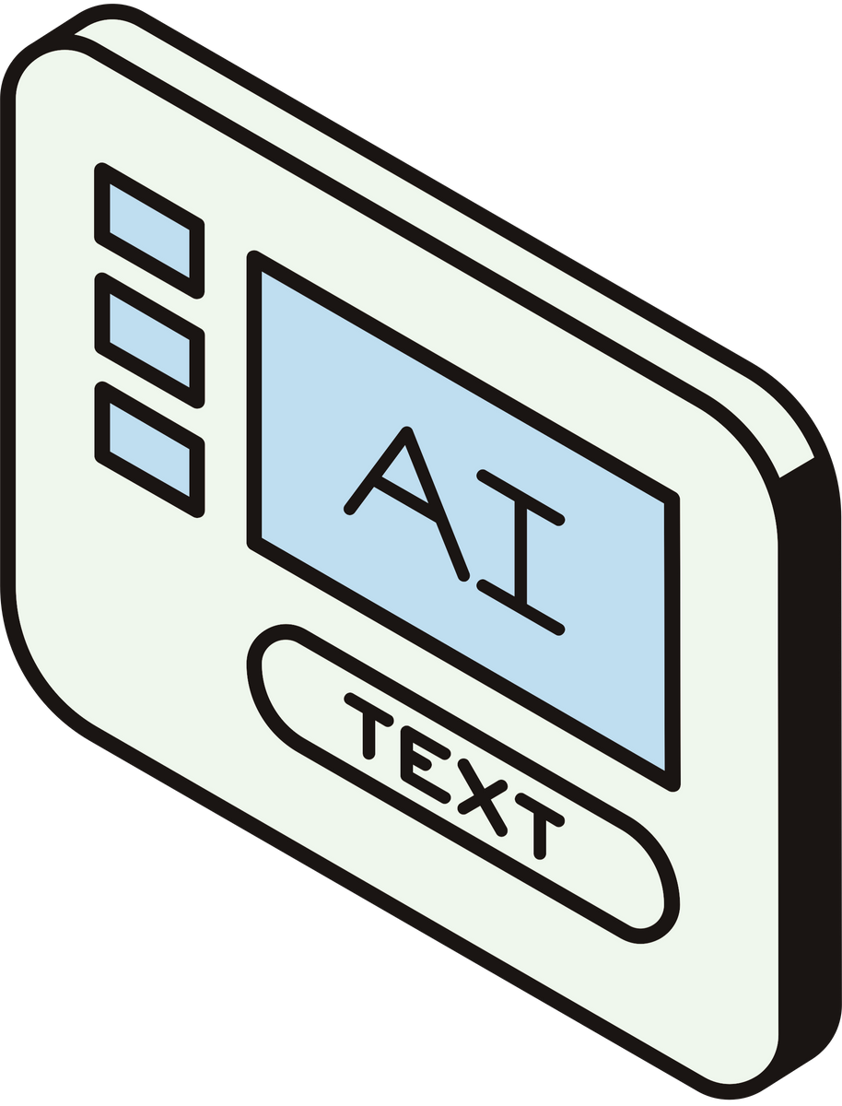
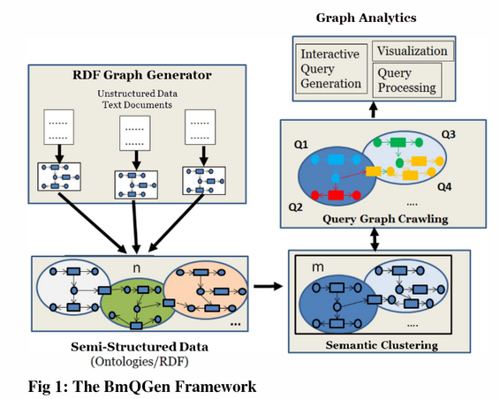
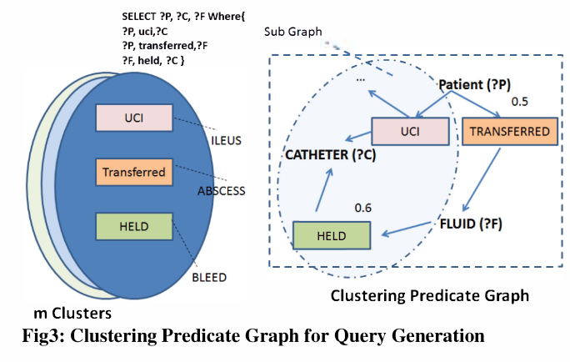
TEXT GENERATION FOR HEALTH QUERY

Slide 29
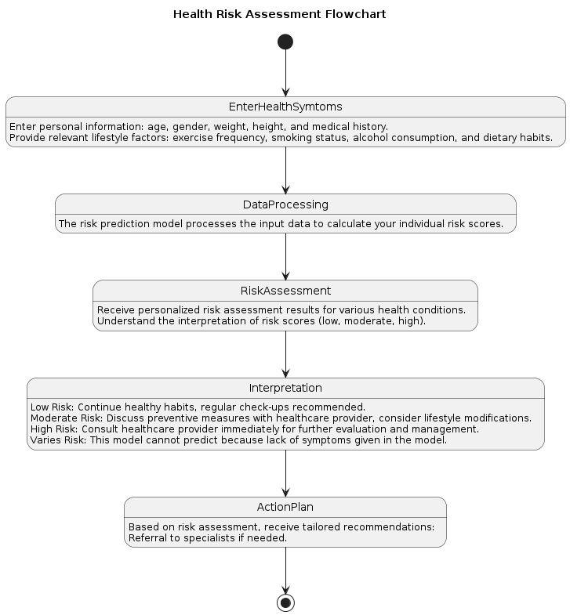

RISK PREDICTION

Slide 30
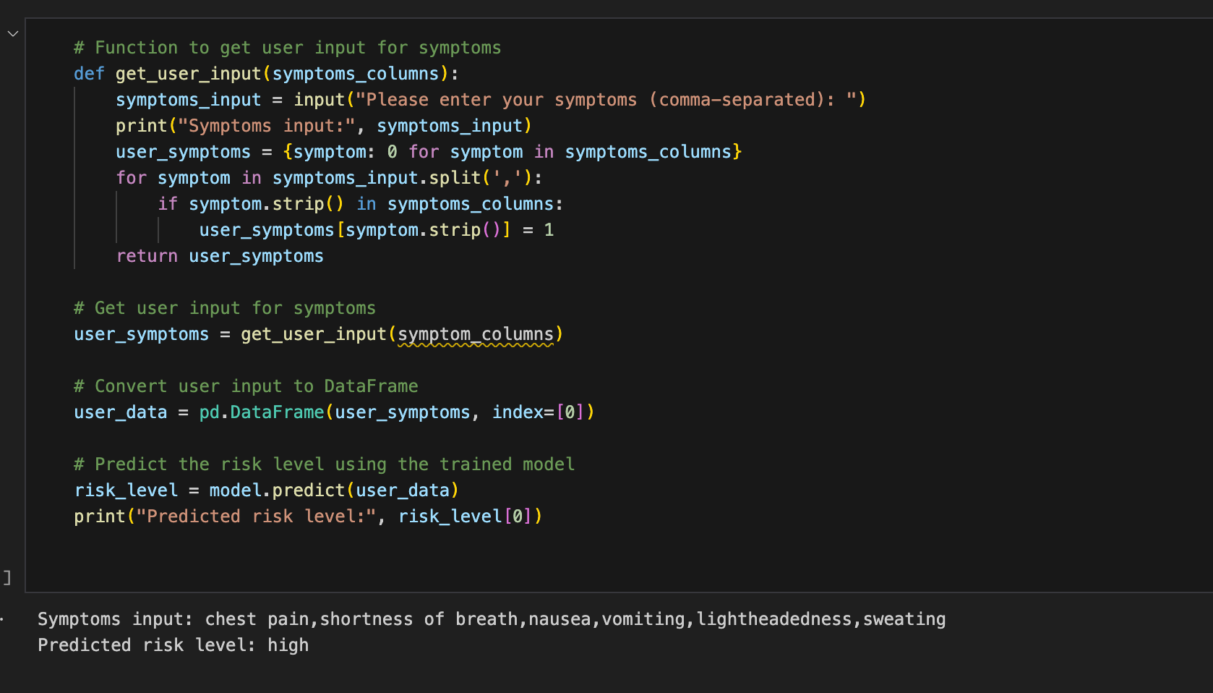
RISK PREDICTION

Slide 31

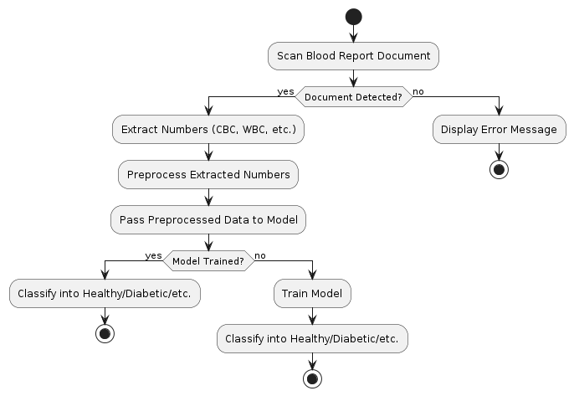
DOCUMENT ANALYSER FOR BLOOD REPORT

Slide 32
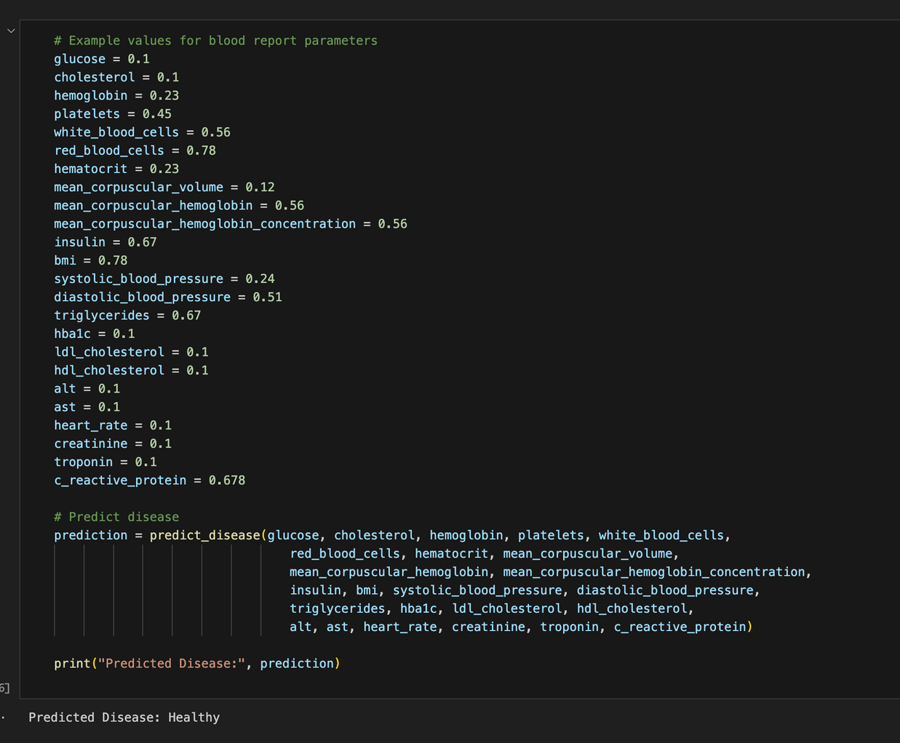
DOCUMENT ANALYSER FOR BLOOD REPORT

Slide 33
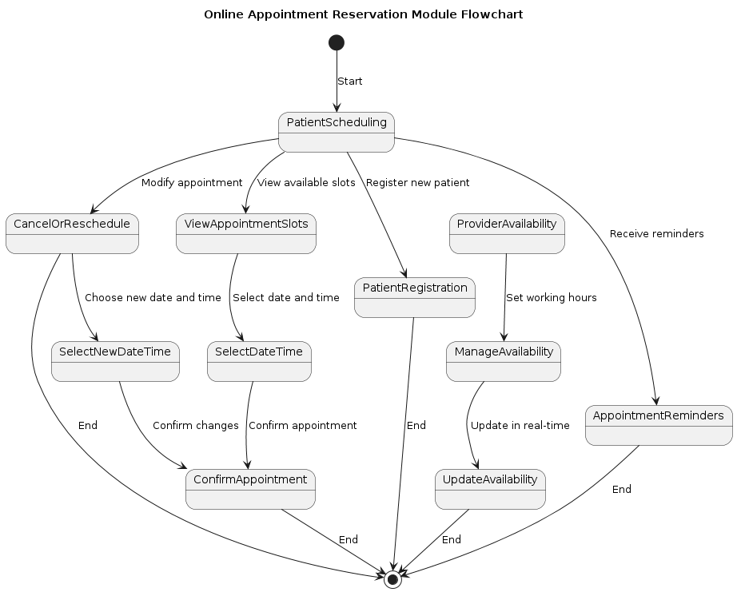
ONLINE
APPOINTMENT
RESERVATION

Slide 34
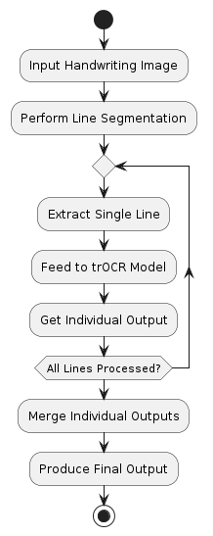
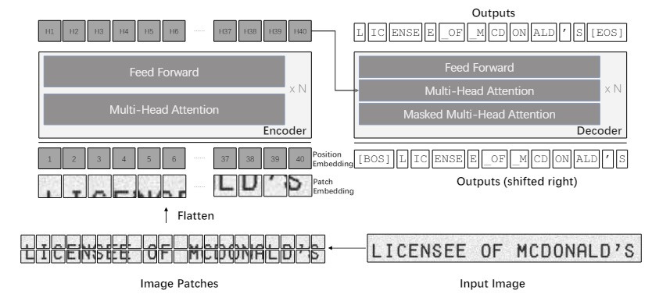
OCR HANDWRITING RECOGNITION

Slide 35
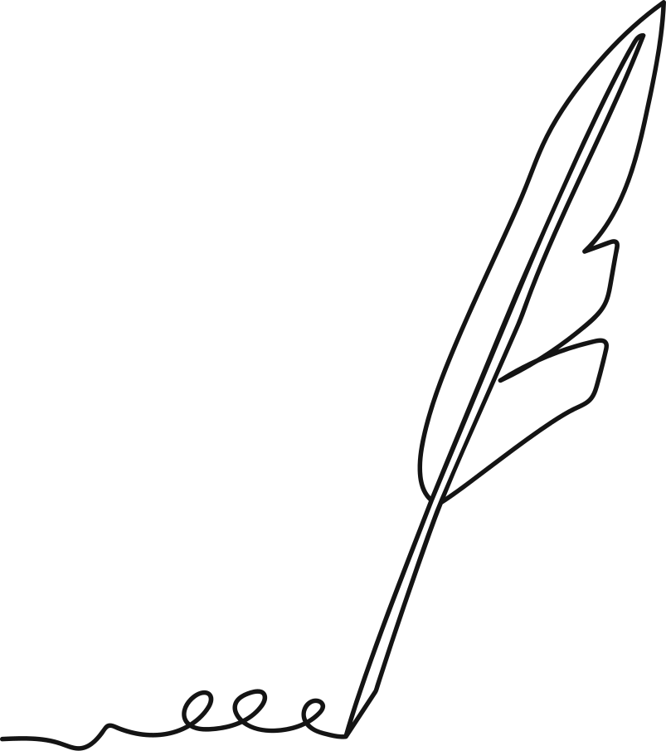
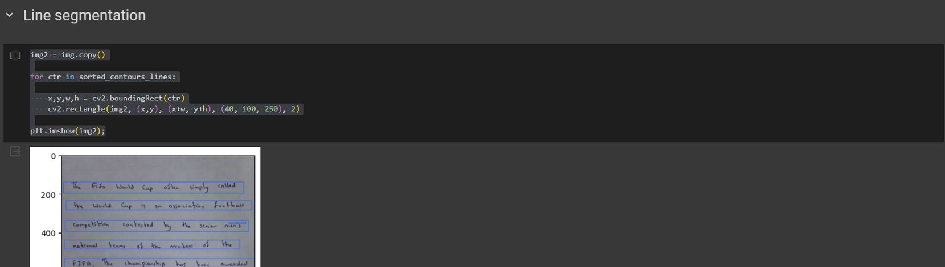
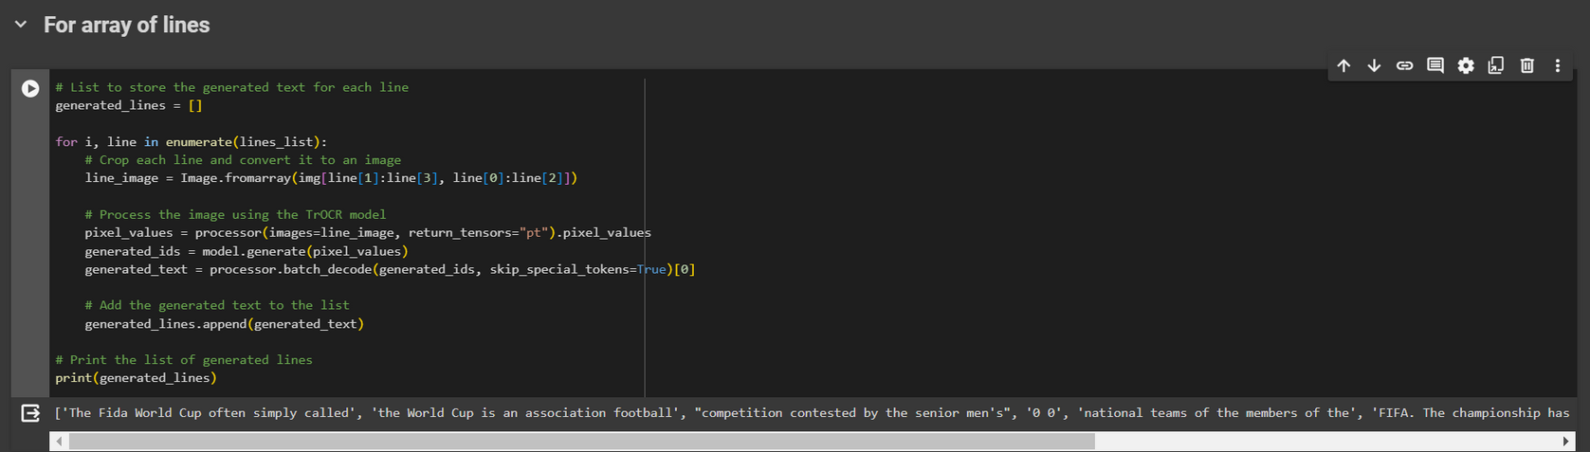
OCR HANDWRITING RECOGNITION

Slide 36
PERFORMANCE METRICS

Slide 37
Model | Performance Metrics
Kidney Stone Detection Model
Brain Tumor Model
Alzheimer Model

Slide 38
Model | Performance Metrics
Skin Cancer

Slide 39
IMPLEMENTATION DETAILS

Slide 40
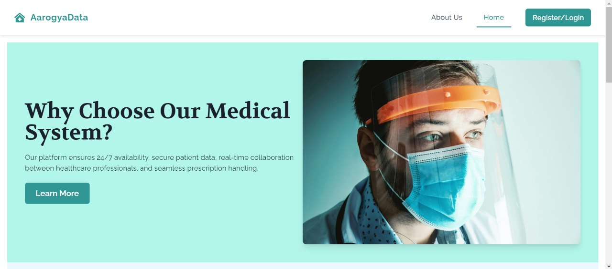
HOME PAGE

Slide 41
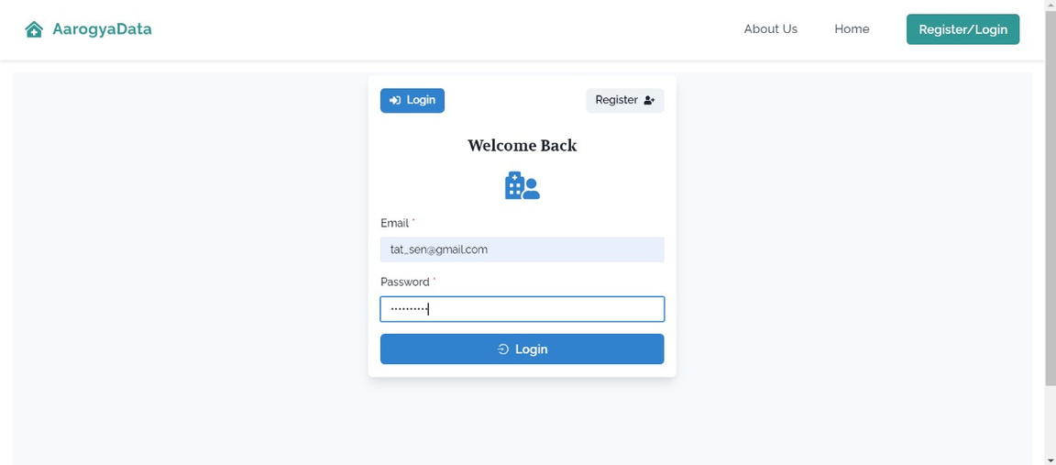
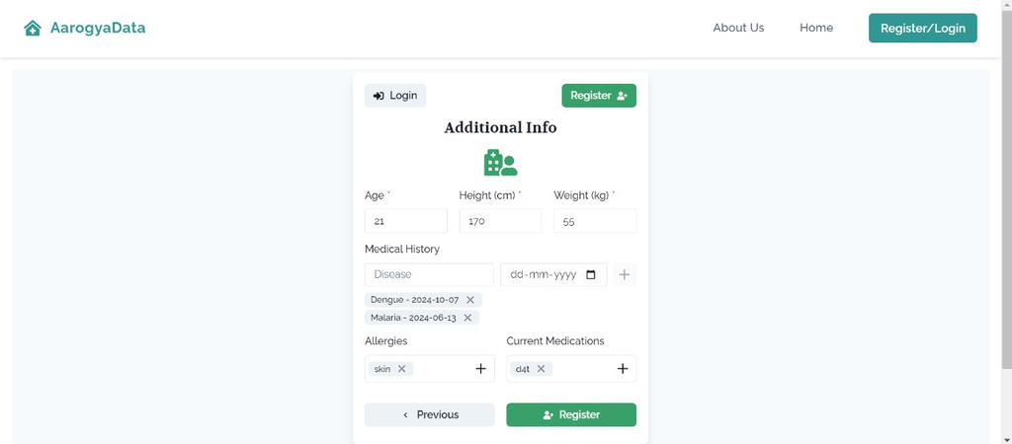
LOGIN AND REGISTRATION
PATIENT LOGIN PAGE
PATIENT REGISTRATION PAGE

Slide 42
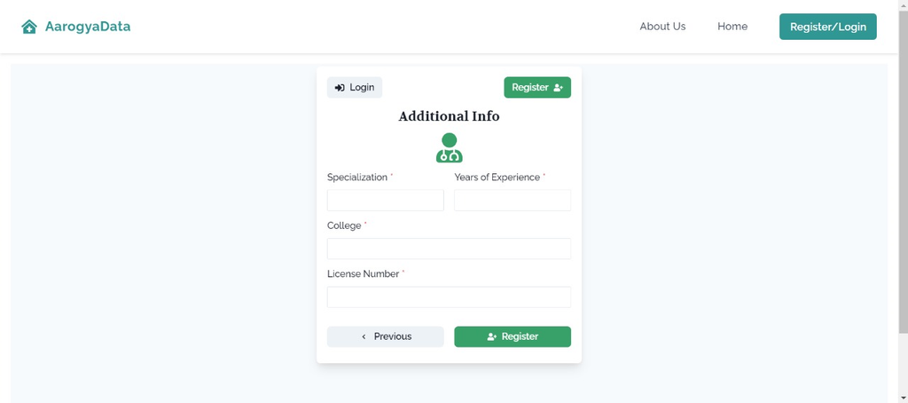
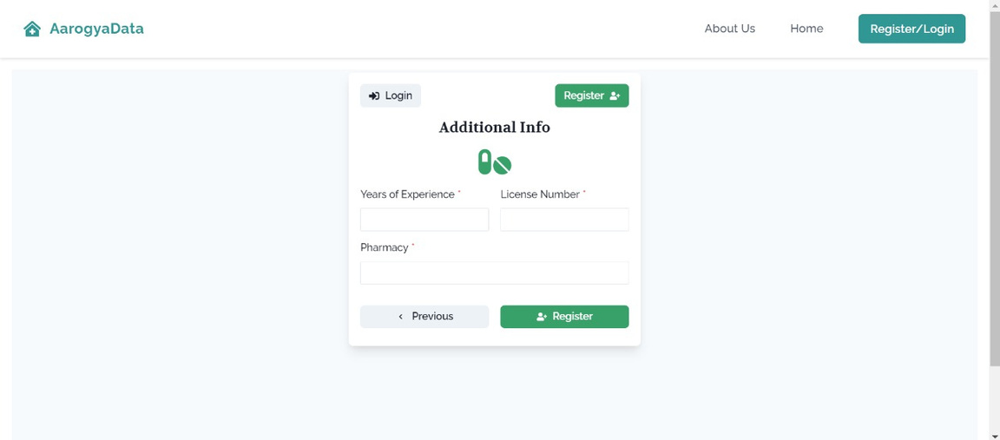
LOGIN AND REGISTRATION
DOCTOR LOGIN PAGE
PHARMACIST LOGIN PAGE

Slide 43
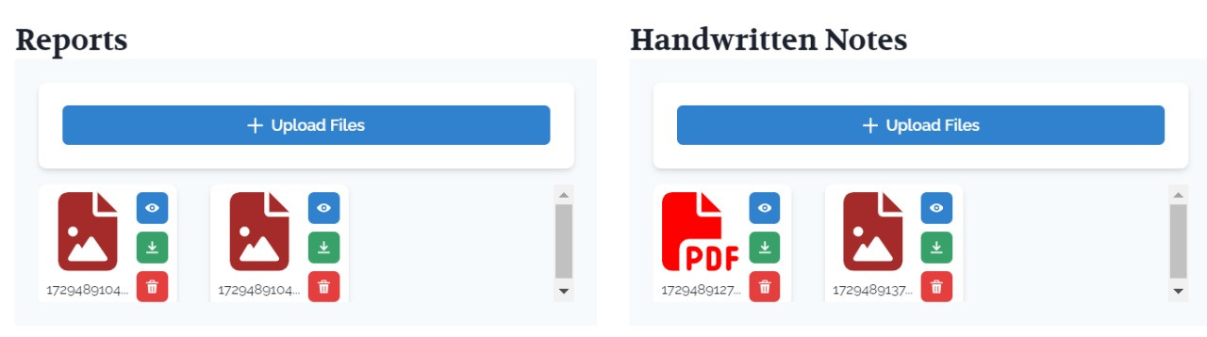
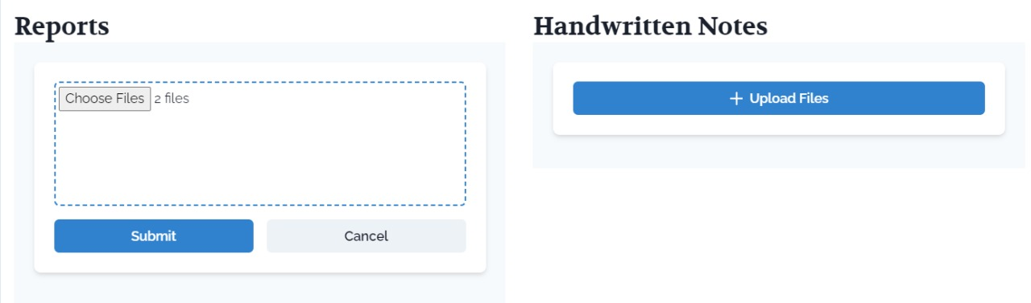
FEATURES
REPORT ANALYSER AND HANDWRITTEN PRESCRIPTION CONVERTER

Slide 44
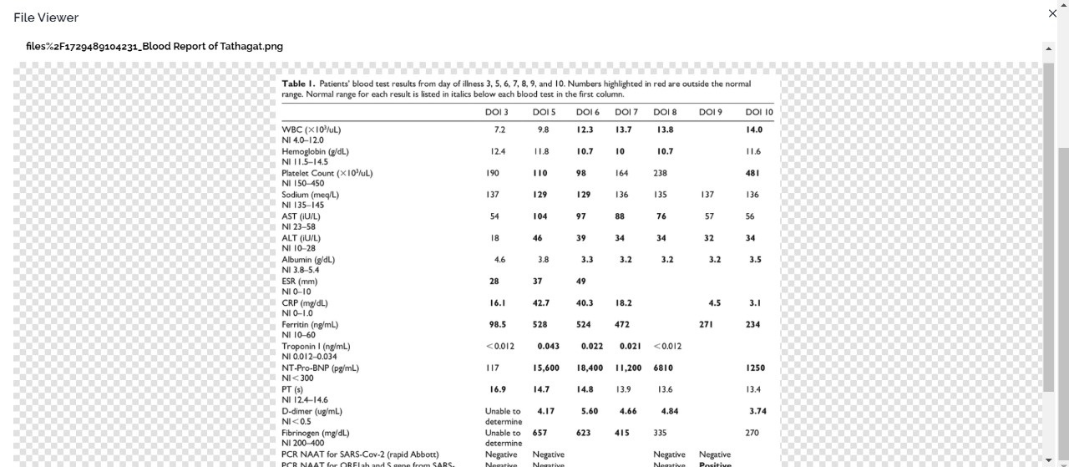
SAMPLE REPORT

Slide 45
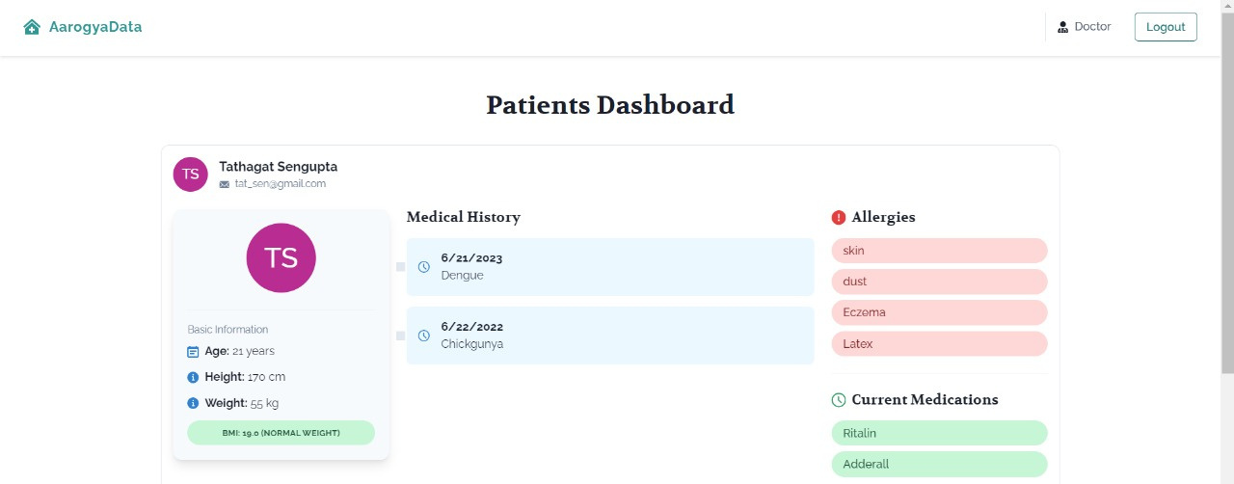
PATIENT DASHBOARD

Slide 46
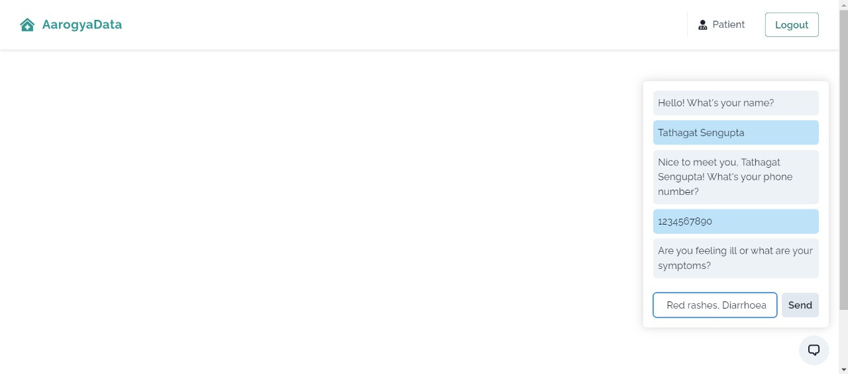
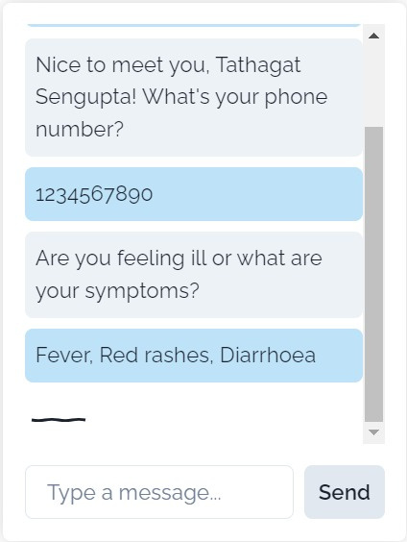
PERSONAL AI CHATBOT

Slide 47
PERSONAL AI CHATBOT

Slide 48


QR CODE SCANNER

Slide 49


